Slide 1



Smart Air Bears
Garima Raheja
John Stuart
Matt Choi
Brian Tam
CE 186
Fall 2017
University of California, Berkeley
Smart Air Bears
empowered personal pollution monitoring
for all
Notes:
garima and everyone says names

Slide 2
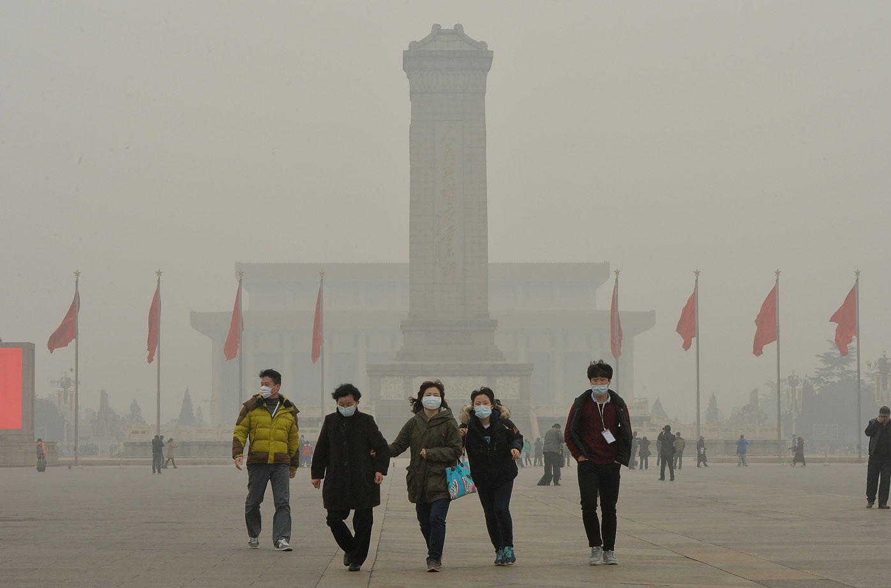
Notes:
garima
People around the world live in air like this. They work, jog, swim, play in air like this. It burns - it burns our lungs and our eyes.

Slide 3
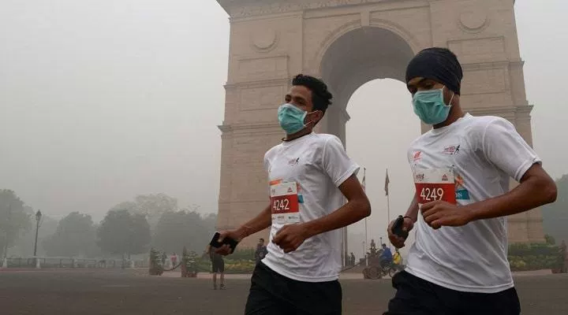
Notes:
garima
I grew up in New Delhi, India, where people ran marathons this year in air quality that necessitated wearing a mask.

Slide 4
1 85%
1 in 8
billion people suffer from respiratory illnesses
aggravated by contaminated air
of the world’s population lives in areas
that do not meet WHO Air Quality Guidelines
global deaths are attributed to poor air quality
Notes:
garima
air quality is a global problem that hurts 1 billion people, and affects 85% of our world population. it’s no surprise that 1 in 8 global deaths can be linked to poor air quality.

Slide 5
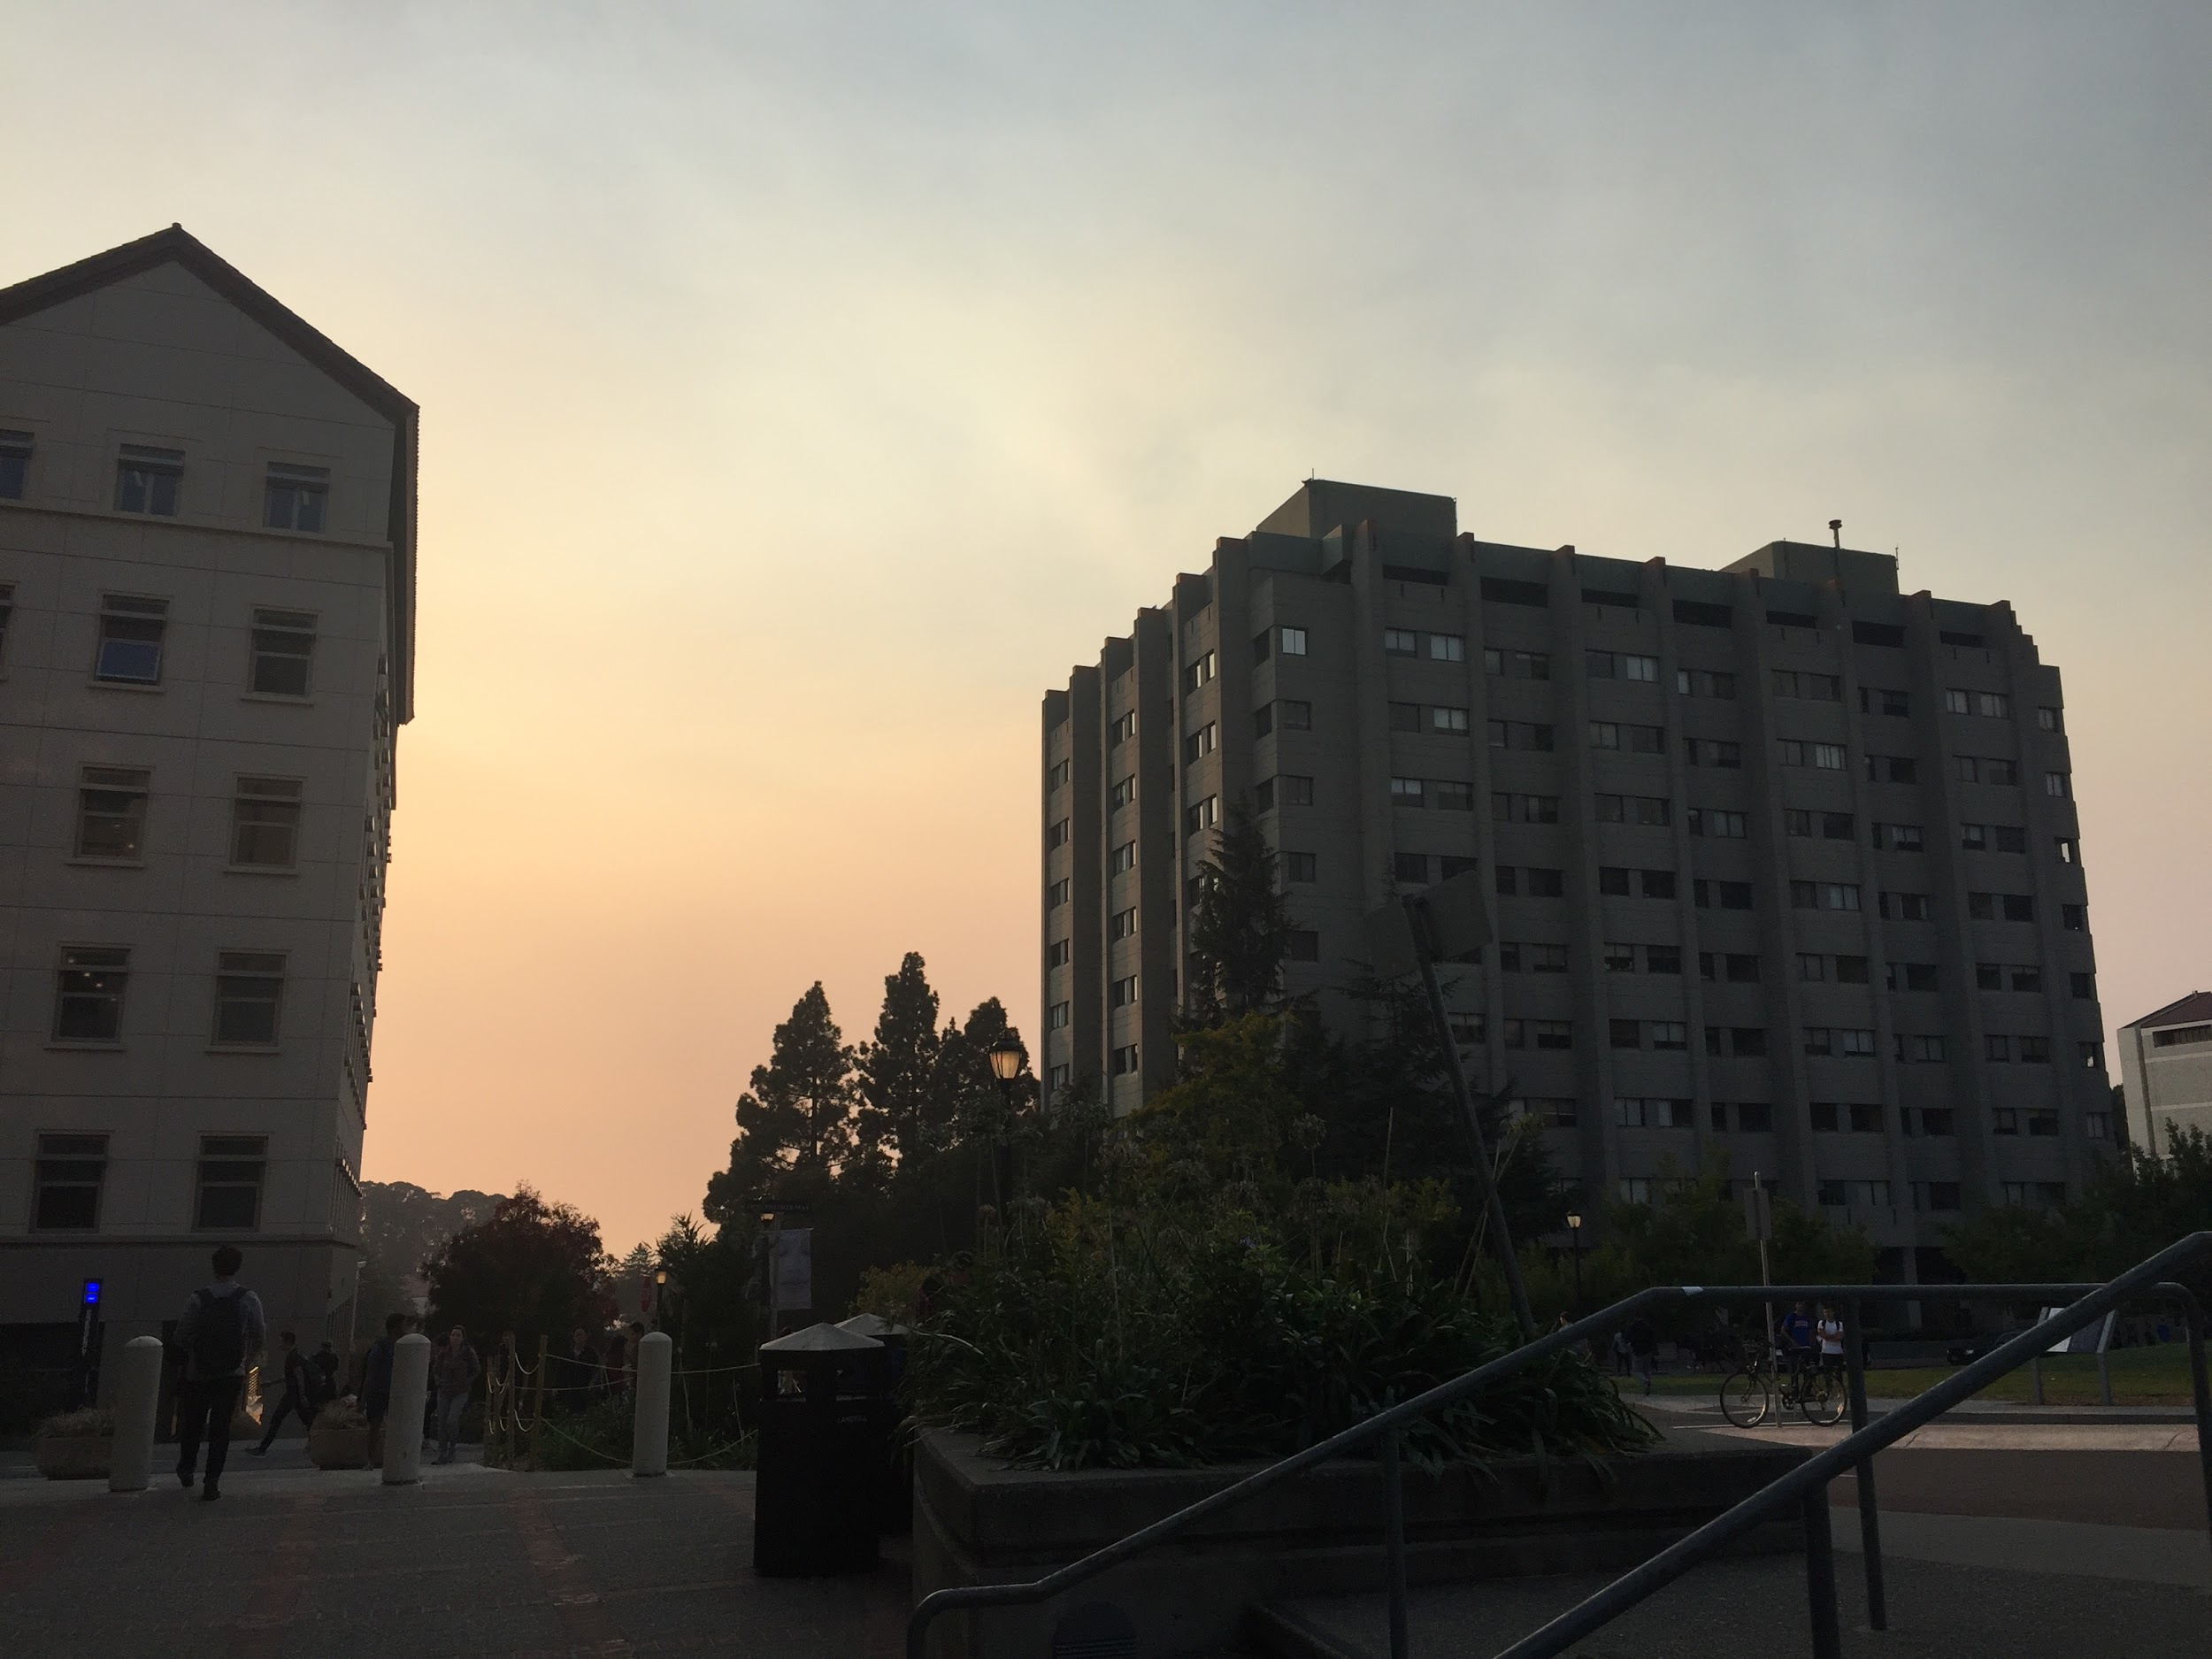
Notes:
john
Bringing this closer to home - even the Bay Area is no stranger to air pollution. We can all remember the day we woke up to a sight like this, a sight where there was no world beyond Evans Hall.

Slide 6

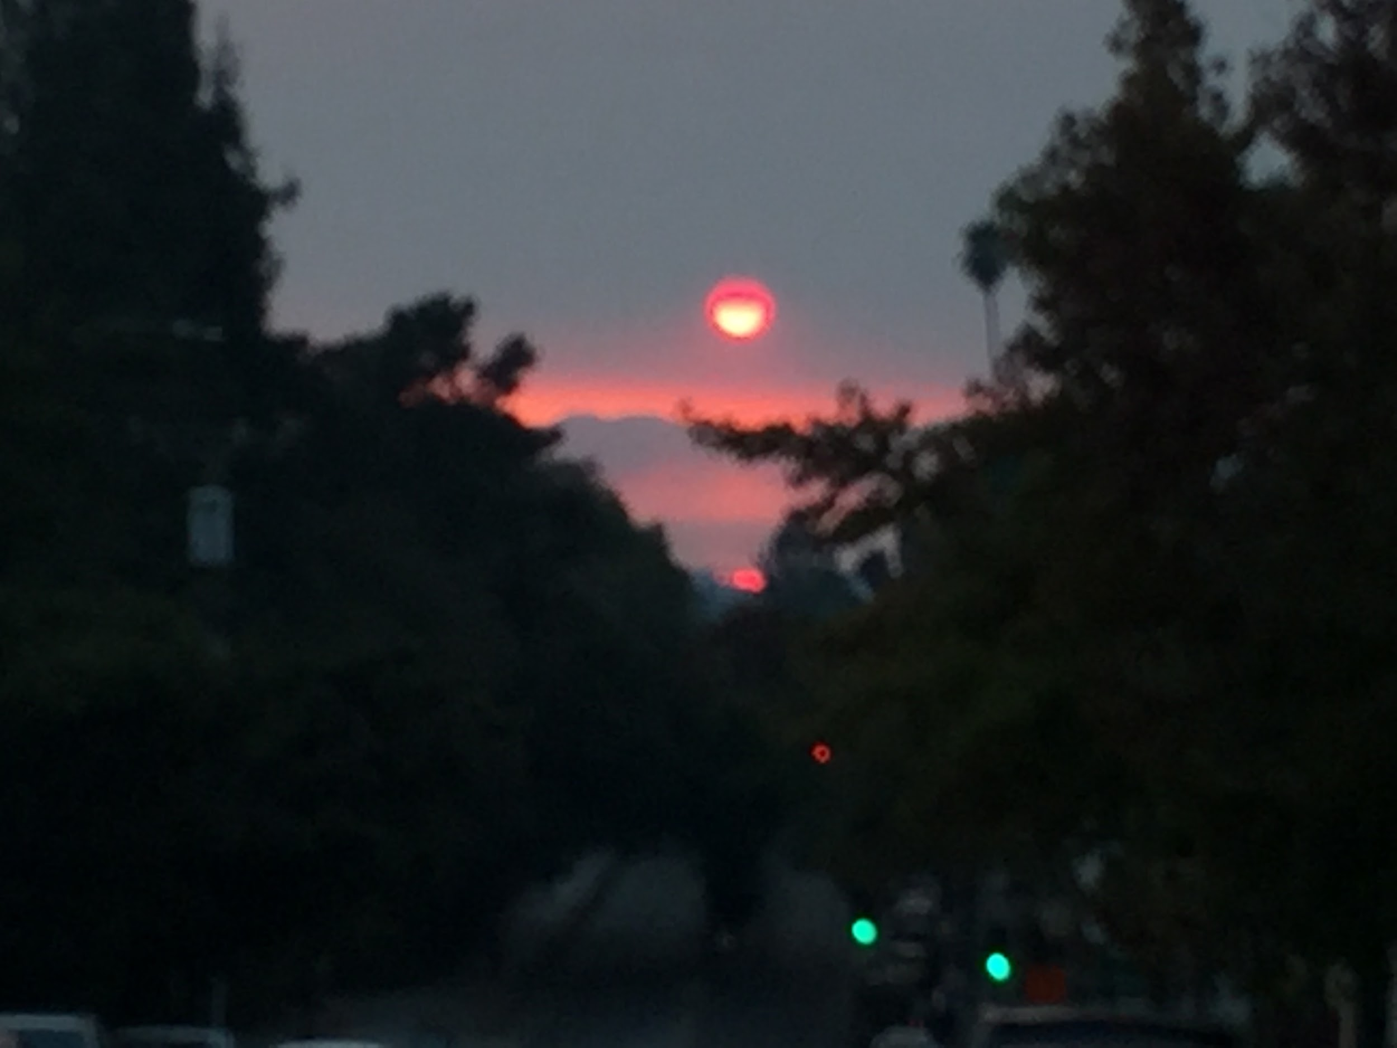
Notes:
john
We went to sleep that night with a pink haze all around, the sun a bloody orange.

Slide 7

Notes:
John
Views like this
This is the view from Treasure Island on a normal Bay Area day.

Slide 8

Notes:
John
Changed to views like this
This is the view from Treasure Island at sunrise on the first day of the wildfires. (pause)

Slide 9
PM10
O₃
CO₂
SO_{x}
VOC
PM2.5
NO_{x}
Notes:
brian
But see, the interesting thing about air pollution is that there’s stuff in the air even when you can’t see it.

Slide 10
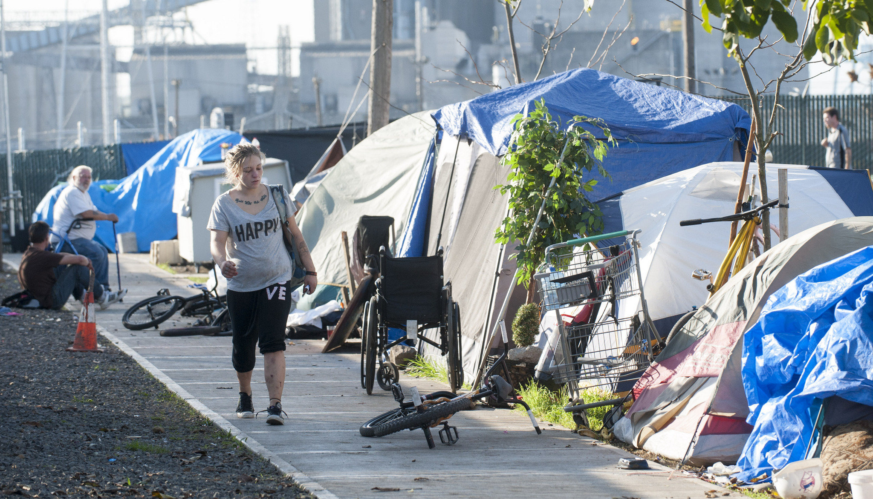
Notes:
brian
Another thing is that air pollution hits hardest on those who have already been hit hard. Think about the communities like homeless folks for whom the concept of indoors and outdoors is blurred.

Slide 11
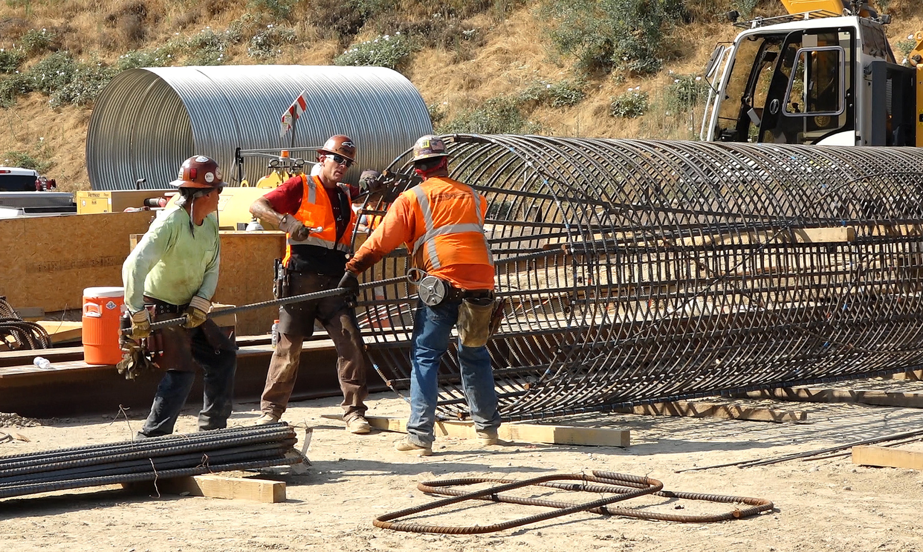
Notes:
brian
Think about those for whom being outdoors is not a choice but a requirement.

Slide 12
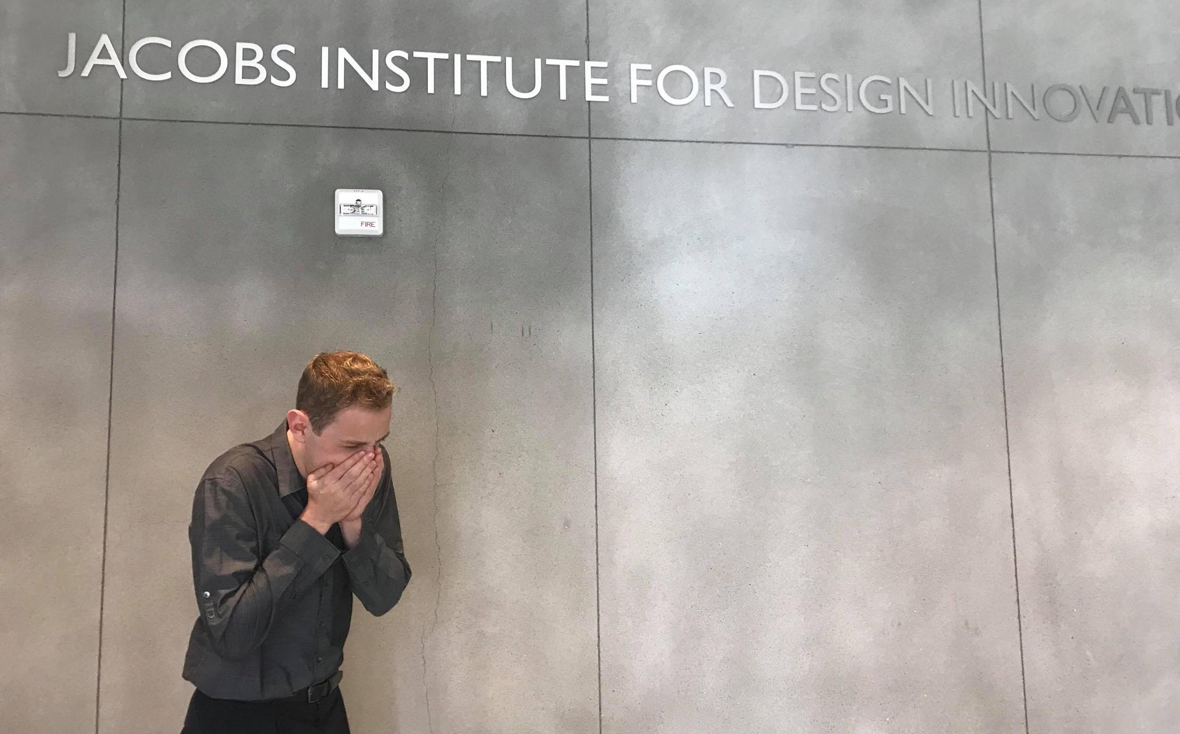
john coughing in jacobs hall
Notes:
brian
bringing it to jacobs hall - think about how air quality affects you

Slide 13
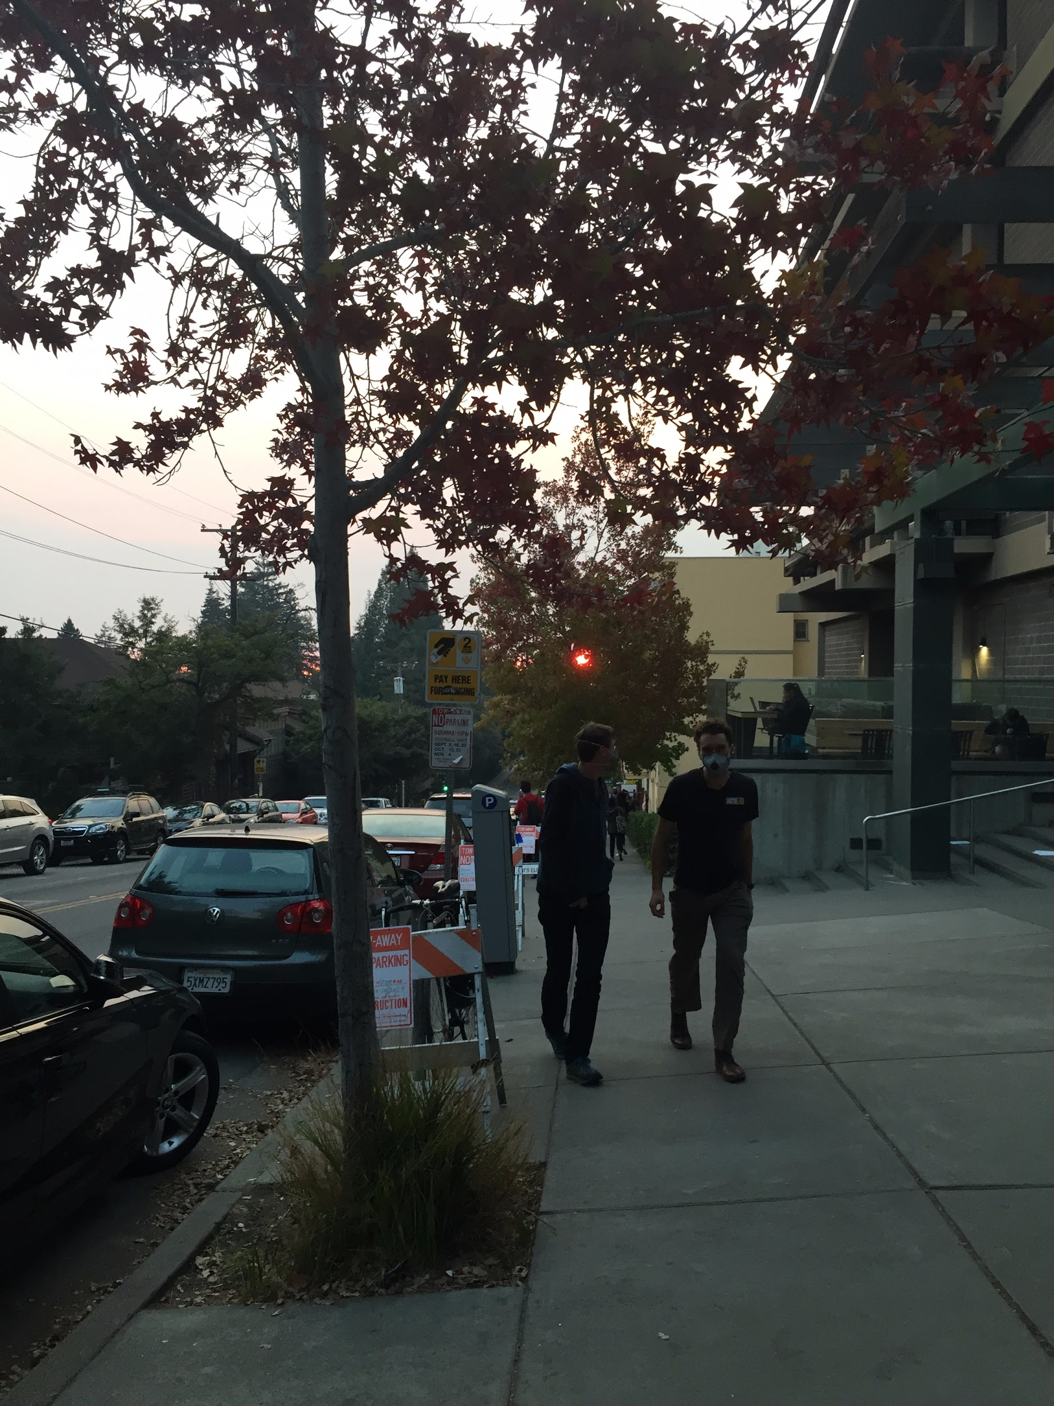
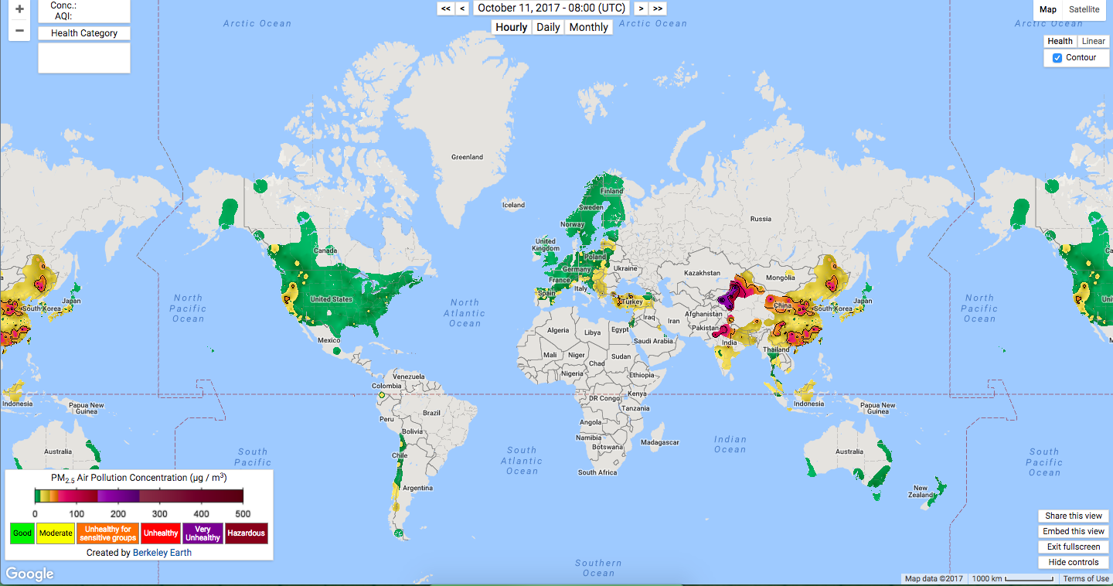
Notes:
brian
The crazy thing about air pollution is it hits hard on everyone. Rich or poor, big or small, if you live in a city with bad air, you’re going to be exposed to it. There are hundreds of cities around the world with periodic intervals of toxic air pollution - this is a societal scale problem. And often it hits hardest on those already disadvantaged by society. This is an environmental justice problem.

Slide 14


PM what?
Notes:
garima
The problem here is that air pollution is confusing.

Slide 15




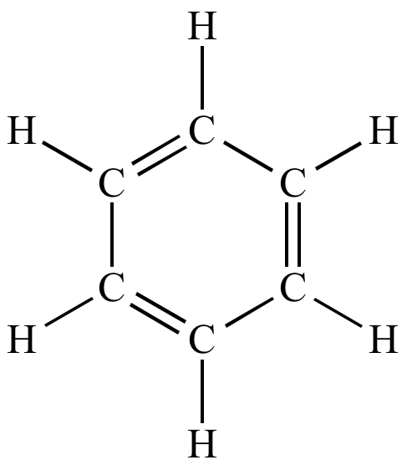





PM
CO₂
VOC
Notes:
garima
The problem here is that air pollution is confusing.

Slide 16
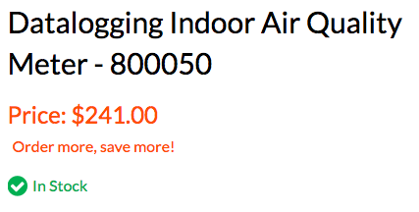
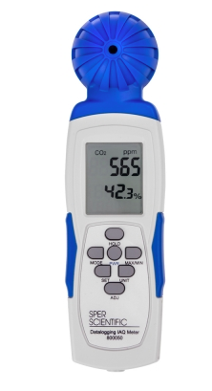
Notes:
garima
If you try to figure out the air around you, that’s expensive. Personal air quality monitors price in the hundreds.

Slide 17
$$
Notes:
garima
If you try to figure out the air around you, that’s expensive. Personal air quality monitors price in the hundreds.

Slide 18
$$
expensive
Notes:
garima
If you try to figure out the air around you, that’s expensive. Personal air quality monitors price in the hundreds.

Slide 19
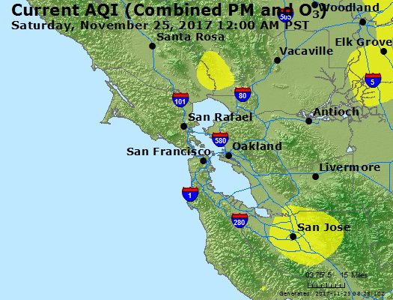
Notes:
garima
If you try to figure out whats going on around you, the data on air quality is too general for your specific location
FIX TRANSITIONS

Slide 20



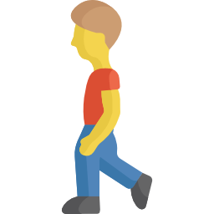
Notes:
garima
If you try to figure out whats going on around you, the data on air quality is too general for your specific location
FIX TRANSITIONS

Slide 21
impersonal
Notes:
garima
If you try to figure out whats going on around you, the data on air quality is too general for your specific location
FIX TRANSITIONS

Slide 22
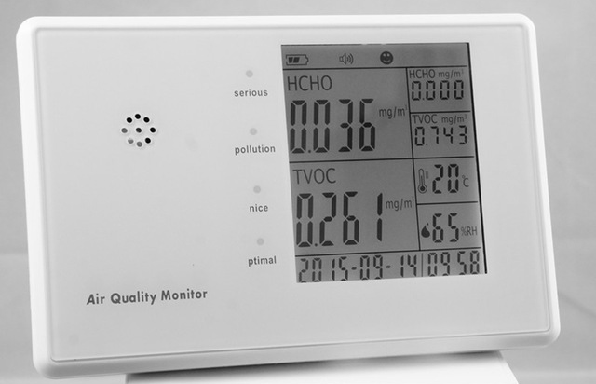
Notes:
garima
And even if you had all the information in the world, there are no tools to help you make the decisions you need to make to help yourself.

Slide 23
?
?
windows
mask
safe
purifier
?
?
move
outdoors
go for a run
Notes:
garima
And even if you had all the information in the world, there are no tools to help you make the decisions you need to make to help yourself.

Slide 24
?
?
windows
mask
safe
purifier
?
?
move
unhelpful
outdoors
go for a run
Notes:
garima
And even if you had all the information in the world, there are no tools to help you make the decisions you need to make to help yourself.

Slide 25
Smart Air Bears
empowered personal pollution monitoring
for all
Notes:
matt
This is why we present to you - Smart Air Bears.

Slide 26
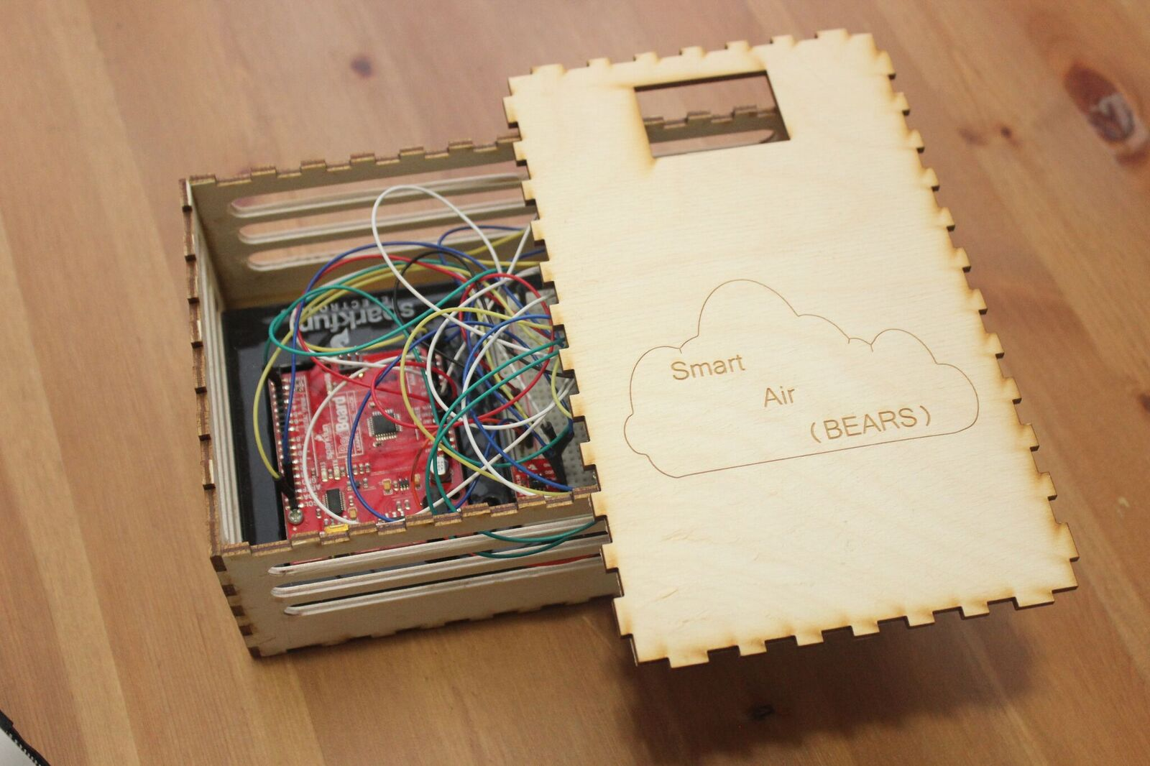
Our Product
Low-cost personal pollutant monitor and decision-making tool
low-cost ambient air quality sensor + mobile app
COST $59
POLLUTANTS
fine particulate matter (PM)
volatile organic compounds (VOC)
carbon dioxide (CO₂)
temperature, relative humidity
TOOLS
granular, location-based air quality mapping
personal air improvement recommendations
Motivation
Product
Implementation
Impact
Notes:
matt
Our product is a low cost smart airquality sensor that monitors air pollutants including PM, VOCs, CO2 as well as temperature and relative humidity and provides health recommendations … to help users achieve healthier life style.
slide: building with sensor next to it; sensor with measurement values. vision is to have one everywhere, indoors and outdoors.
“explain empower educate”

Slide 27







Cloud and Crowdsourcing
Ambient pollution data sent to cloud and then to stakeholders
CO₂
VOC
PM
Motivation
Product
Implementation
Impact
Notes:
Matt
Our instrument monitors the air around u, sends to cloud, then brings the crowdsourced data back.
We want to empower u to make decisions about ur own health, and also the governement regulatory agencies to have the power to create widespread policy-based change.

Slide 28










The vision
Ubiquitous ambient air pollution monitoring + useful recommendations
$
Σ % + #
1 0 1 1 0
0 1 1 1 1 1
Motivation
Product
Implementation
Impact
Notes:
matt
we made this with the vision of making an air quality sensor with a price low enough that you could find a sensor inside and outside every building, crowdsourcing engouh data to create hyperlocalized maps of the air around you
our vision is also that the cloud can act as a guide and a doctor, providing healthcare recommendations specific to the user and their immediate surroundings

Slide 29



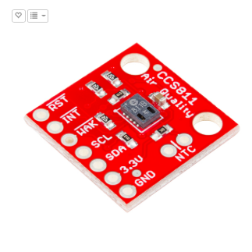
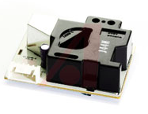
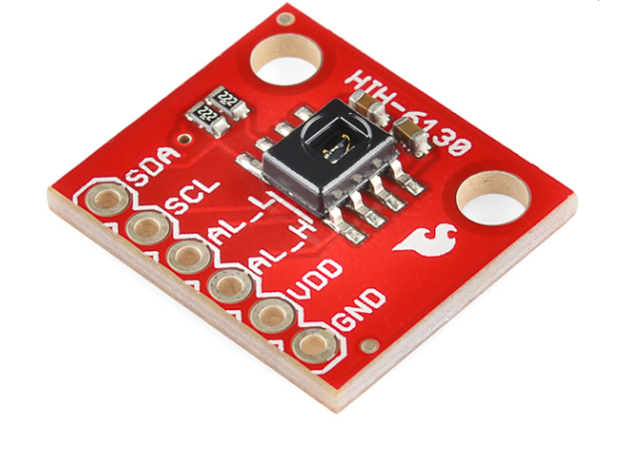
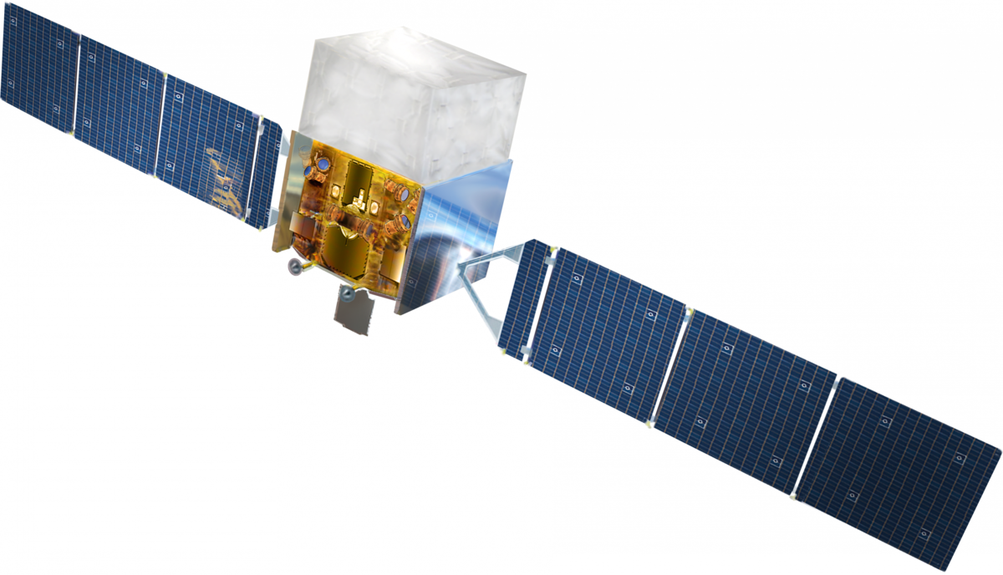
Hardware
Low-cost sensors provide affordable air quality monitoring
VOC
CO₂
PM
%
SparkFun Air Quality Sensor
Breakout Model # CCS811
Amphenol Advanced Sensors SM-PWM-01C
SparkFun Humidity and Temperature Sensor Breakout - HIH6130
In-Built Geoloc
& Satellite Data
Motivation
Product
Implementation
Impact
Notes:
garima
A couple things that make our system really cool. low cost makes it unique. affordable makes it accessible to communities around the world. we talked about air quality hitting hardest on the communities already hit hard by society - our low cost sensors are an effort to be accessible to those communities, to be accessible to everyone
ADD PRICES (find total cost of shit)

Slide 30
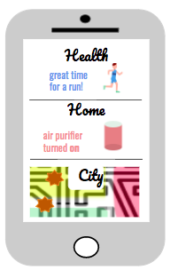
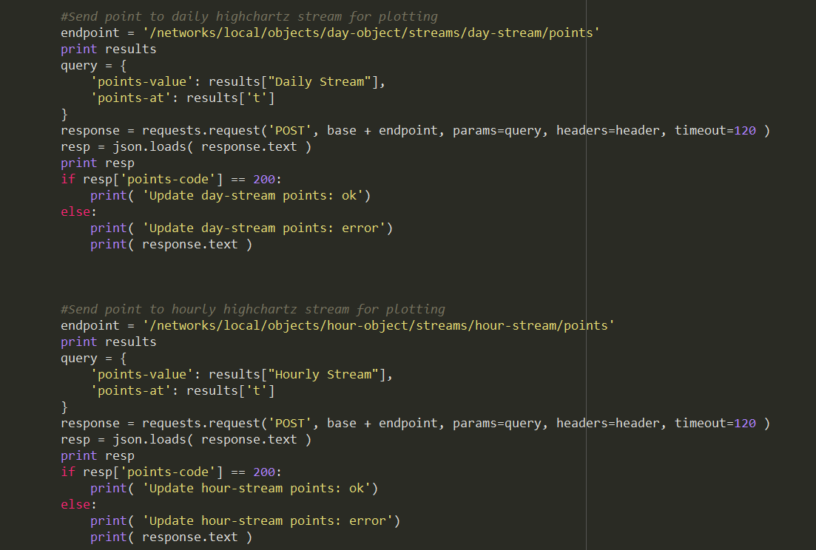

Cyber-Physical Integration
Cloud-computing creates algorithm-driven recommendations
user history
prescription information
1 0 1 1 0
0 1 1 1 1 1
personal health data
regional average
building facilities
lifestyle suggestions
building commands
CO₂ >
PM 2.5 = Standards
VOC <
relocation suggestions
doctor recommendation
Motivation
Product
Implementation
Impact
Notes:
garima
Another thing that makes our system unique - our connection to the cloud. fundamental.
make cool cloud computing slide (cloud icon, also the listen and process diagram, show that cloud makes heat map - crowdsourcing and also recommendation engine - machine learning, based on EPA / science)

Slide 31



Recommendation Platform
Cyber-physical elements provide personalized recommendations
machine learning algorithms and scientific standards are used to generate personal health recommendations
Health
great time
for a run!
sensors connect with smart home devices (IoT) to maintain
indoor air quality
Home
air purifier
turned on
crowdsourcing provides outdoor air quality based recommendations for safe breathing areas
City
Motivation
Product
Implementation
Impact
Notes:
John
Sensors connect to IOT devices to actuate upon this data and allow for automated control of HVAC, operable windows, and other systems for improving air quality.

Slide 32
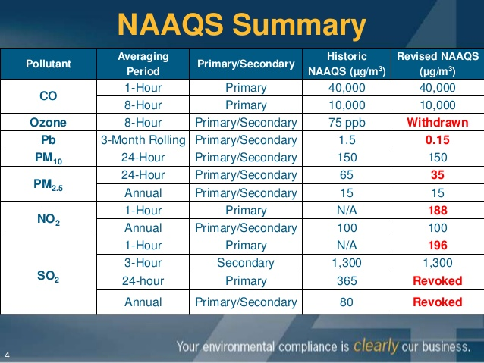
Science-Based EPA Air Quality Standards
Verified standards used to make decisions about ambient air quality
pollutant-
specific
measurable concentrations
temporal
Motivation
Product
Implementation
Impact
Notes:
john
recommendations are based on science

Slide 33
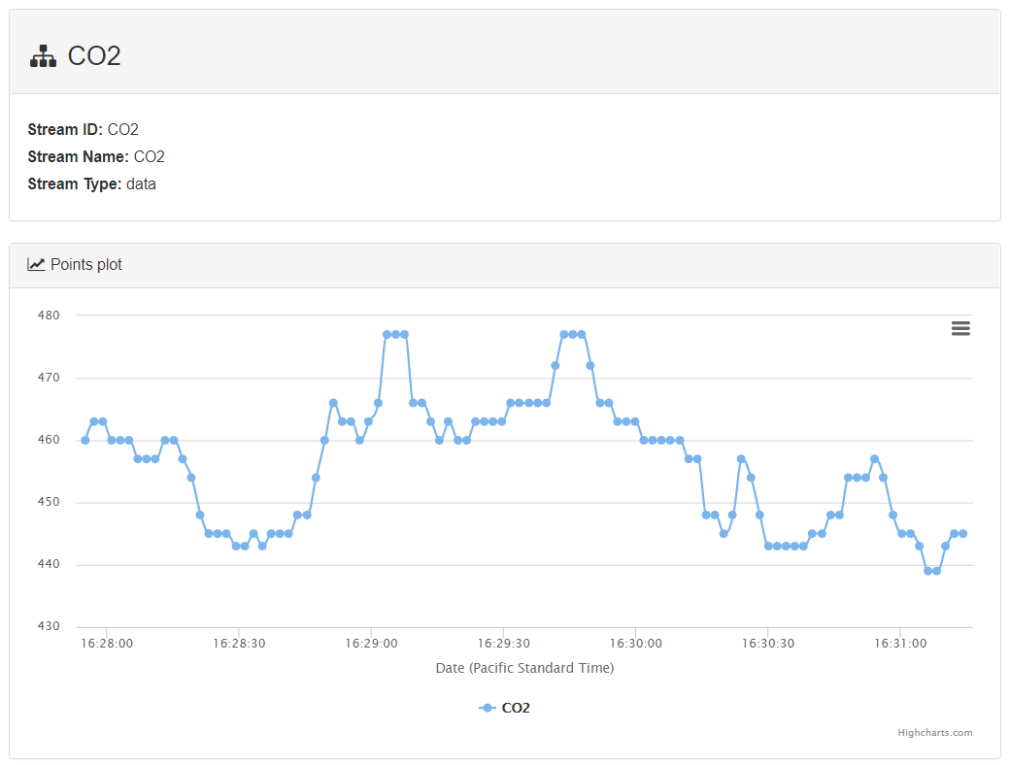
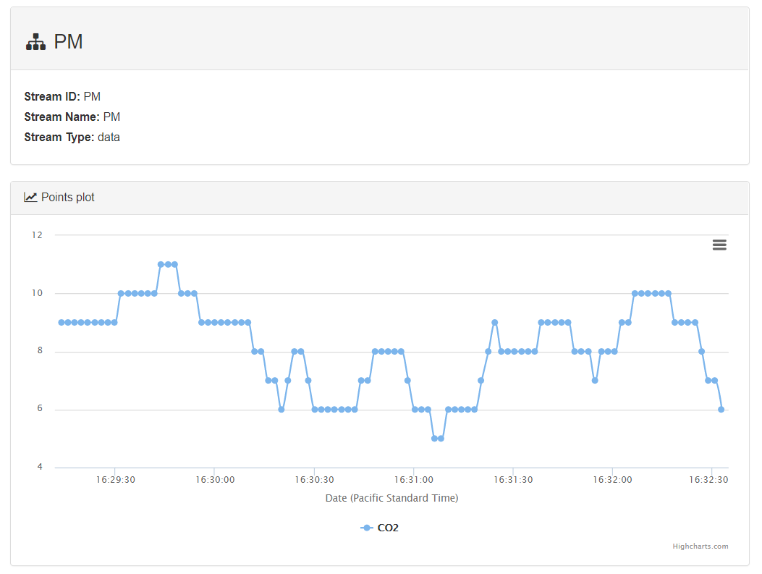
Real-Time Monitoring
Web visualization helps contextualize ambient air with regional standards
Motivation
Product
Implementation
Impact
Notes:
John
For users that want to see the granular details of their air quality, our web platform provides readouts of various pollutants and measures of indoor air quality.
Users could use these peaks and valleys with a knowledge of their own li
we want to make this science understandable. contexualization helps u understand - wallflower pico web visualization. real time data and contexualization.
understand ur exposure compared to regional average and EPA standard
make smart, empowered decisions

Slide 34
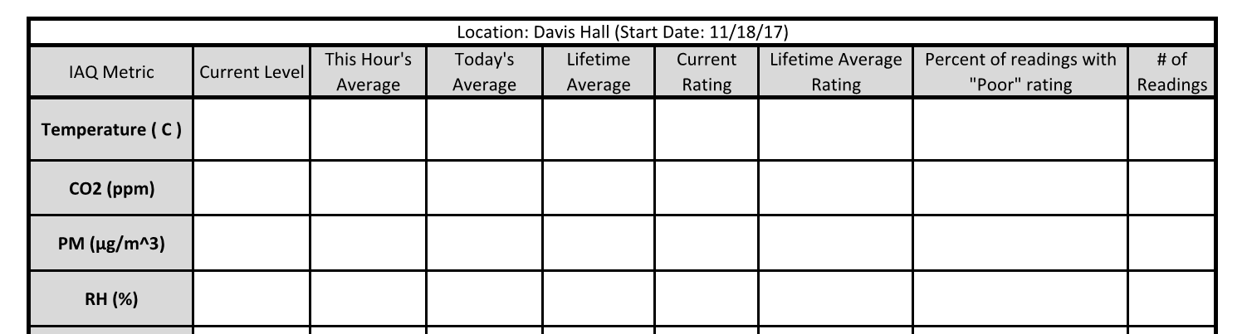
User-Friendly Analysis
Outputs a simple rating system to users ( both real time and lifetime)
22.9
-
-
-
-
-
-
462
430
414
451
Good
Good
1%
152
16
20
28
27
Fair
Fair
3%
61
58
52
52
Fair
Good
20%
Motivation
Product
Implementation
Impact
Notes:
john
we want to make this science understandable. contexualization helps u understand - wallflower pico web visualization. real time data and contexualization.
understand ur exposure compared to regional average and EPA standard
make smart, empowered decisions

Slide 35
Data for All
Air quality data is shared with stakeholders and regulatory agencies
CO₂
VOC
PM
BAAQMD
EPA
City Council
State Capitol
Motivation
Product
Implementation
Impact
Notes:
brian another key part of the vision of this project is that data is sent to the government and regulatory agencies who can take a look, find out which communities are hit hardest by hazardous air, and create policy and technical solutions to reduce emissions. so that includes, the bay area air quality management district, epa region 9, and local governments that can make policies to create change.

Slide 36



Impact
Data-backed recommendations for empowered communities
educate
explain
empower
Motivation
Product
Implementation
Impact
Notes:
garima
What kinds of impacts can we expect?
Small lifestyle changes that can improve health, such as 30% reductions in asthma symptoms from replacing carpeting with hard flooring
Even small productivity gains in the workplace due to more alert and less sick workers can lead to financial incentives
RH affects disease, so monitoring it more closely can help prevent not only respiratory irritation but also disease transmission
Overall, better health, comfort, and a sense of control for people over the environmental quality they spend every day in.

Slide 37
Demo!
Motivation
Product
Implementation
Impact
Notes:
brian
What kinds of impacts can we expect?
Small lifestyle changes that can improve health, such as 30% reductions in asthma symptoms from replacing carpeting with hard flooring
Even small productivity gains in the workplace due to more alert and less sick workers can lead to financial incentives
RH affects disease, so monitoring it more closely can help prevent not only respiratory irritation but also disease transmission
Overall, better health, comfort, and a sense of control for people over the environmental quality they spend every day in.

Slide 38
Thank You
Data-backed recommendations for empowered communities
Professor Scott Moura
CE 186 Fall 2017 Cohort
GSIs Saehong & Dong
Judges
Professor Bill Nazaroff
Motivation
Product
Implementation
Impact
Notes:
brian
What kinds of impacts can we expect?
Small lifestyle changes that can improve health, such as 30% reductions in asthma symptoms from replacing carpeting with hard flooring
Even small productivity gains in the workplace due to more alert and less sick workers can lead to financial incentives
RH affects disease, so monitoring it more closely can help prevent not only respiratory irritation but also disease transmission
Overall, better health, comfort, and a sense of control for people over the environmental quality they spend every day in.

